Slide 1
Checkpointing

Slide 2
Overview
Applications with long execution times run a significant risk of encountering a hardware or software failure before the completion.
Long execution times also frequently violate some supercomputer usage policies where a maximum wallclock limit for a simulation is established.
The consequences from a hardware or software failure can be very significant and costly in terms of time lost and computing resources wasted for long running jobs.
At designated points during the execution of an application on a supercomputer the data necessary to allow later resumption of the application at that point in the execution can be output and saved. This data is called a checkpoint.

Slide 3
Uses for checkpoint files
Checkpoint files help mitigate the risk of a hardware or software failure in a long running job.
Checkpoint files also provide snapshots of the application at different simulation epochs, help in debugging, aid in performance monitoring and analysis, and can help improve load-balancing decisions for better distributed memory usage.

Slide 4
Checkpointing Strategies
In HPC applications, two common strategies for checkpoint/restart are employed: system-level checkpoint and application-level checkpointing.
System-level checkpointing requires no modifications to the user code but may require loading a specific system-level library.
System-level checkpointing strategies center on full-memory dumps and may result in very large checkpoint files.
Application-level checkpointing requires modifications to the user code. Libraries exist to assist this process.
Application-level checkpoint files tend to be more efficient since they only output the most relevant data needed for restart.

Slide 5
System-level checkpointing
System-level checkpointing performs the checkpoint and restart procedures via a full memory dump.
This type of checkpointing does not require any changes to the application in order to use and the writing of the checkpoint may be triggered either by the system or the user.
Examples with support for High Performance Computing include the Berkeley Lab Checkpoint/Restart (BLCR), Checkpoing/Restore in Userspace (CRIU), and Distributed MultiThreaded CheckPointing (DMTCP).

Slide 6
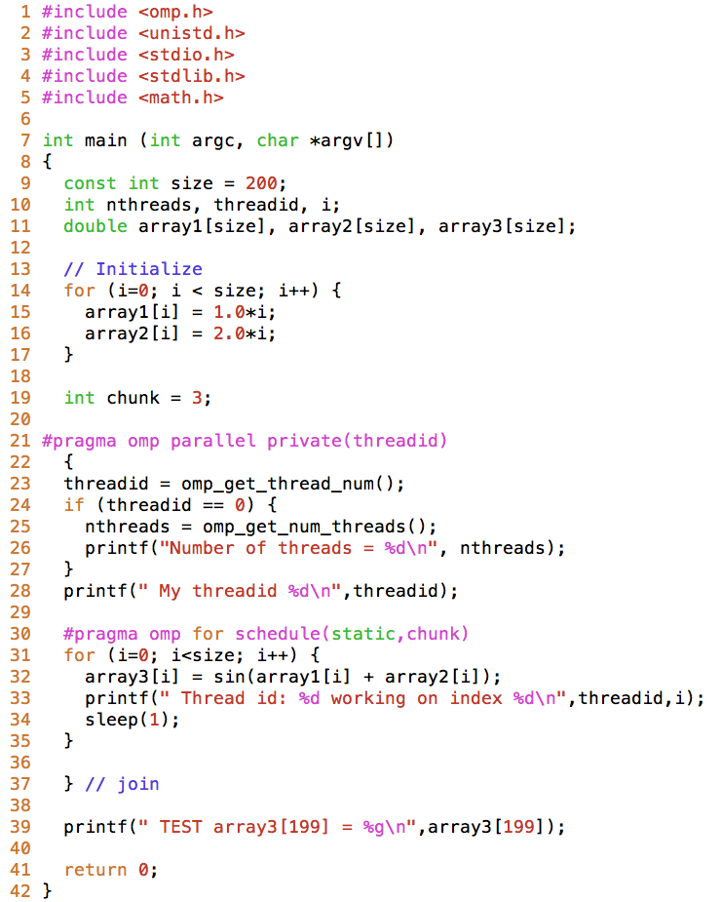
Example: System-level checkpointing with DMTCP
The code is compiled as normal:
gcc –fopenmp –O3 –o checkpoint_openmp checkpoint_openmp.c -lm
The code number of OpenMP threads is also specified in the normal way
export OMP_NUM_THREADS=16
The executable is launched with checkpoint capability using the dmtcp_launch tool:
dmtcp_launch ./checkpoint_openmp
Notes:
DMTCP Distrbuted multithreaded checkpointing

Slide 7
Example: System-level checkpointing with DMTCP
Request for checkpoint is manually executed in the dmtcp_coordinator command interface or pre-supplied as follows:
DMTCP checkpoint files have the naming convention of
ckpt_<executable name>_<client identity>.dmtcp
and are written in the directory where the executable was launched.
The checkpoint file is restarted using the dmtcp_restart command:
dmtcp_command –-interval <checkpoint interval in seconds>
dmtcp_restart <checkpoint file>

Slide 8
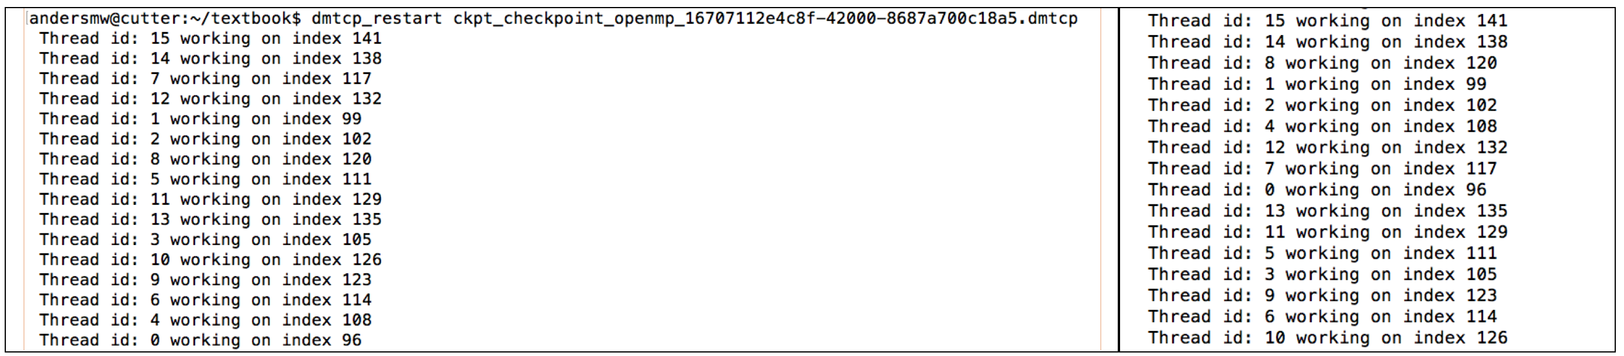
Example: System-level checkpointing with DMTCP
The standard output from the example code after checkpoint restart (left) and without restart (right). The same OpenMP threads operate on the same indices and all operations are identical between the restarted and non-restarted case.

Slide 9
Application level checkpointing
In application-level checkpointing the application developer has the responsibility to perform all checkpoint/restart operations.
While inconvenient, application-level checkpoint/restart tends to produce checkpoint files that are smaller than system-level checkpoint/restart where a full memory dump is performed.
For distributed memory applications based on MPI, application-level checkpoint/restart approaches often share some basic characteristics:
Only one checkpoint file is written per MPI process
Only one MPI rank accesses a single checkpoint file
Checkpoint files do not contain data from multiple checkpoint epochs
Checkpoint files are generally written to the parallel file system by the compute nodes
Checkpoint/restart overheads can be large.

Slide 10
Application level checkpointing
Application-level checkpoint/restart implementations generally pick designated points in the computational phase in the simulation algorithm for checkpointing in order to ensure computational phase consistency in the checkpoint epoch
Application-level checkpoint/restart is very popular in large-scale MPI applications and toolkits because it can be tailored for the application to be as efficient and minimal as possible.
The Scalable Checkpoint/Restart (SCR) library assists application-level checkpoint strategies by reducing the load on a parallel file system and by partially utilizing non-parallel fast storage local to a compute node for checkpoint file storage with some redundancy in the event of a failure on the local storage.

Slide 11
MapReduce

Slide 12
MapReduce
MapReduce is a simple programming model for enabling distributed computations including data processing on very large input datasets in a highly scalable and fault-tolerant way
The details of the underlying parallelization in MapReduce are hidden from the programmer thereby making it easier to use
A map is a functional that executes a supplied function on all members of an input list
The results of the map function and associated groupings are passed to the reduce function
The map functions, like the reduce functions, can be executed concurrently giving a significant potential for speedup.
Distributed processing in MapReduce may be summarized in three phases: a map phase, a shuffle phase, and a reduce phase.
The Hadoop project provides an open source implementation of the MapReduce programming model

Slide 13
Map Function
A map is a functional that executes a supplied function on all members of an input list.
The map function itself returns a set of two linked data items: a key for lookup and a value.
Example: suppose the map function counts the number of characters of an input word, returning as a key the word length and returning as a value the input word:
this is a book high performance computing
key | Grouped values
1 | “a”
2 | “is”
4 | “this”, “book”, “high”
9 | “computing”
11 | “performance”
Result from map function:
Notes:
Removed the word about form this is a book about high performance computing

Slide 14
Reduce Function
The reduce function takes as an argument a key and all values associated with that key
Like the map function, the reduce function can also be executed independently on each key and grouping of values thereby enabling embarrassingly parallel execution.
Example: A reduction function that simply counts the number of grouped values associated with each key. Using the output from the previous map function, this gives:
key | Output from reduce function
1 | 1
2 | 1
4 | 3
9 | 1
11 | 1
Thus there are three words of length four while only one word of each of the other counts.

Slide 15
Word Count Example
Counting the number of times each word has been used in a body of text is the canonical didactic example for MapReduce.
The map function returns as a key a single word and the associated value with the key is unity.
Example: To be or not to be – that is the question
The reduce function simply sums up the grouped values
Key | Grouped Values
“to” | 1, 1
“be” | 1, 1
“or” | 1
“not” | 1
“that” | 1
“is” | 1
“the” | 1
“question” | 1
Key | Output from Reduce function
“to” | 2
“be” | 2
“or” | 1
“not” | 1
“that” | 1
“is” | 1
“the” | 1
“question” | 1

Slide 16
Word Count: Hamlet
Running the Word Count map and reduce function on the entire text of Shakespeare’s Hamlet gives the following word counts for some common words:
Key | Output from Reduce function
“but” | 269
“as” | 222
“be” | 210
“England” | 21
“Norway” | 13

Slide 17
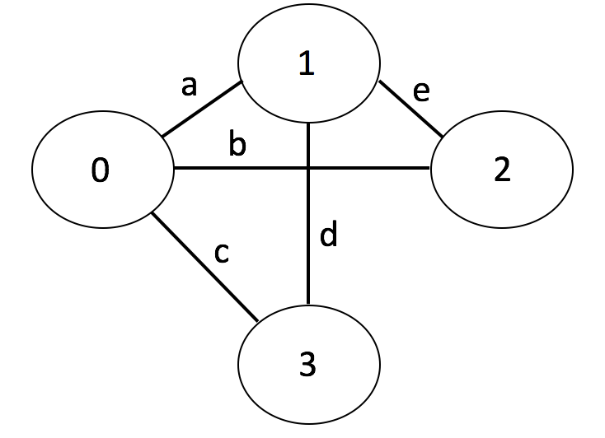
Shared Neighbors
Finding shared neighbors in graph applications provides another good example of MapReduce functionality
In this graph vertex “0” shares a common neighbor with vertex “2”; this common neighbor is vertex “1”. MapReduce can be used to find those shared neighbors.

Slide 18
Shared Neighbors: Map
The map function returns each edge of a vertex as a key
The value for each key is the list of all the neighboring vertices to that vertex
The gives the following group values:
Vertex 0 |  | Vertex 1 |  | Vertex 2 |  | Vertex 3
key | values | key | values | key | values | key | values
a | 1,2,3 | a | 0,2,3 | e | 0,1 | c | 0,1
b | 1,2,3 | d | 0,2,3 | b | 0,1 | d | 0,1
c | 1,2,3 | e | 0,2,3
key | Grouped Values
a | (1,2,3), (0,2,3)
b | (1,2,3), (0,1)
c | (1,2,3), (0,1)
d | (0,2,3), (0,1)
e | (0,2,3), (0,1)

Slide 19
Shared Neighbors: Reduce
The reduce function returns the intersection of each key’s grouped values revealing shared neighbors
Here vertices connected by edge “a” also share two of the same neighbors, vertices 2 and 3.
key | Output from reduce function
a | 2,3
b | 1
c | 1
d | 0
e | 0

Slide 20
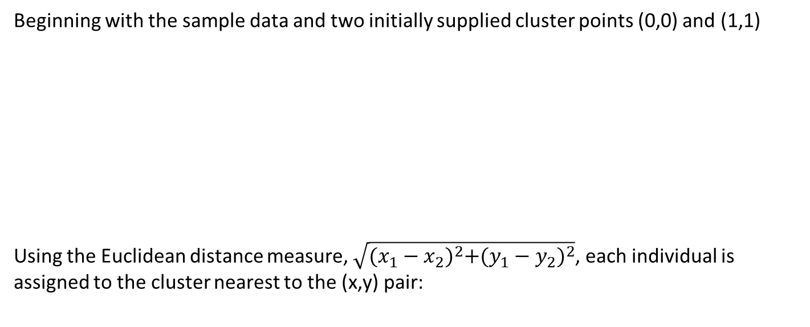
K-means clustering Example
Beginning with the sample data and two initially supplied cluster points (0,0) and (1,1)
Using the Euclidean distance measure, $\sqrt{{(x_{1}−x_{2})}^{2}+{(y_{1}−y_{2})}^{2}}$, each individual is assigned to the cluster nearest to the (x,y) pair:
Individual | (x,y) pair
a | (0.1,0.3)
b | (1.1,0.4)
c | (0.8,0.7)
d | (1.2,1.2)
e | (0.1,1.1)
Cluster 1 |  | Cluster 2
Members | Mean x,y value | Members | Mean x,y value
a | (0.1,0.3) | b,c,d,e | (0.8,0.85)

Slide 21
K-means clustering
In a MapReduce programming model, for a given (x,y) value pair the mapper iterates over each cluster’s mean value and finds the cluster with the nearest distance to the (x,y) pair. It returns as a key the cluster and as a value the (x,y) pair:
The reducer receives a list of (x,y) value pairs for each cluster and computes the new cluster mean value.
This MapReduce operation can be performed iteratively until no more updates occur or until a maximum number of iterations is reached.
key | Grouped values
1 | (0.1,0.3)
2 | (1.1,0.4), (0.8,0.7), (1.2,1.2), (0.1,1.1)
key | Output from reduce function
1 | (0.1,0.3)
2 | (0.8,0.85)

Slide 22
Hadoop
The Hadoop project by Apache provides an open source implementation of the MapReduce programming model.
It provides a distributed file system, job scheduling and resource management tools including YARN (Yet Another Resource Negotiator), and MapReduce programming support.
Historically, MapReduce applications in Hadoop are programmed using Java although support for C++, Python, and a few other languages are also available.
The distributed file system in Hadoop, HDFS, enables distributed file access across many linked storage devices in an easy way.

Slide 23
Hadoop File System Commands
Select Hadoop Distributed File System Commands | Description
hdfs dfs –cat <filename> | Copies the specified filename to stdout.
hdfs dfs –ls | HDFS equivalent of Linux “ls” command.
hdfs dfs –mkdir <directory> | HDFS equivalent of Linux “mkdir” command
hdfs dfs –put <local files>… <destination> | Copy the source files to the destination path in the HDFS
hdfs dfs –get <src> <destination> | Copy the source file to the local file system destination.
hdfs dfs –rm <filenames> | Delete the specified files. Only deletes files.
hdfs dfs –rmr <directory name> | Delete the specified directory and all content.
Example: place hamlet.txt in the Hadoop distributed file system:
hdfs dfs -put hamlet.txt /hamlet

Slide 25
Map Reduce
Takes a set of data, and maps it to a series of queues (so it can be processed in parallel)
Reduce then executes those separate bits in parallel
The rules for map() and reduce() are up to the data scientist to decide, and have no default expected thing.
It’s a bit more complicated than this (we’ll get there in a sec)

Slide 26
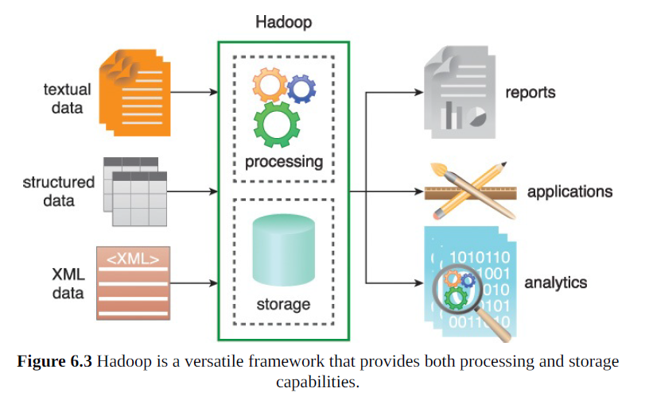
Apache Hadoop

Slide 27
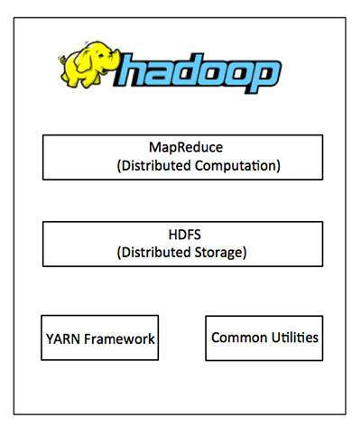
Hadoop
Hadoop is just some software that runs and manages the key things on the right
3 basic steps:
Some files in distributed storage
A program for the map and reduce function
Configuration settings for how to use the cluster
Notes:
https://bigdatapath.wordpress.com/hadoop-introduction/

Slide 28
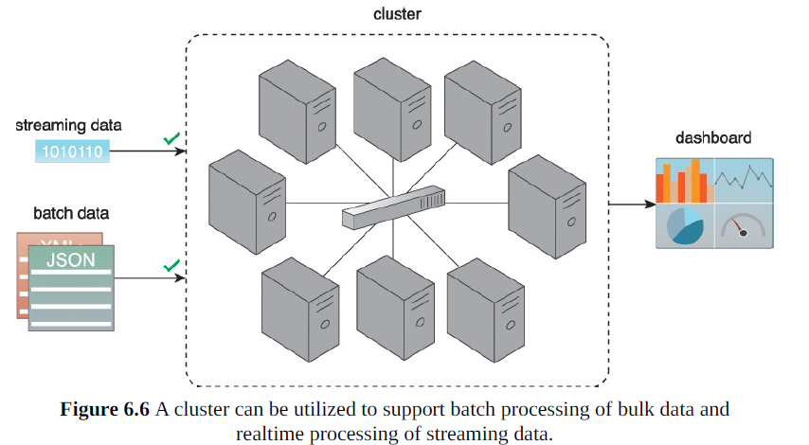
Cluster System (that runs this stuff)

Slide 29
Clusters
Behind the scenes clusters do a lot to deal with hardware failures (compute and storage)
The distributed architecture lends itself to some sort of batch system

Slide 30
Batch vs. Transactional
A bit of jargon
A batch process is where you wait until you have a lot of data, break it up into batches and process them
Transactional process are where the data is processed immediately upon receipt and the result returned as quickly as possible.

Slide 31
Batch Processing: Map Reduce
Map reduce is a framework (/pattern) for doing batch processes
There are no particular constraints on the type of data you work with
There is a coordination overhead in managing a job, (and then summarising the results through some merge at the end)

Slide 32
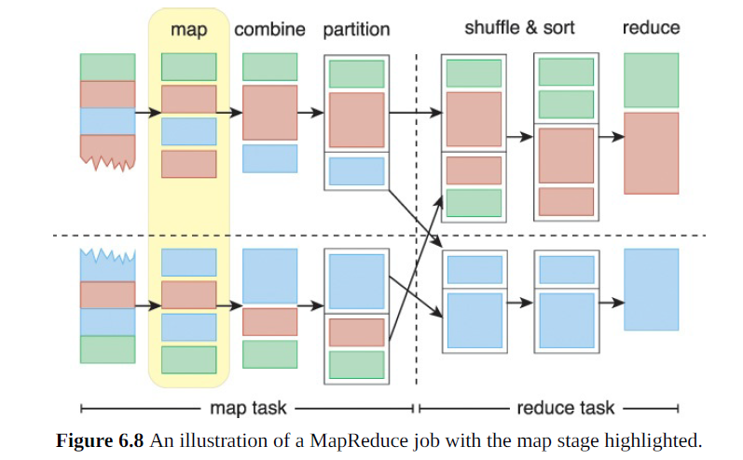
Map Reduce

Slide 33
The Genius of Map Reduce
Traditionally, data processing requires moving data from the storage node to the processing node that runs the data processing algorithm. This approach works fine for smaller datasets; however, with large datasets, moving data can incur more overhead than the actual processing of the data.
With MapReduce, the data processing algorithm is instead moved to the nodes that store the data. (think object oriented programming, only for big data sets)

Slide 34
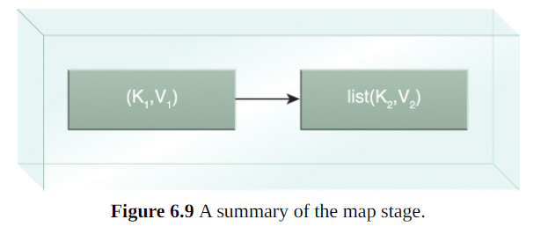
The Map – splitting data
Each split is parsed into its constituent records as a key-value pair.
This is user (data scientist) defined split
Map can also filter and or transform your data

Slide 35
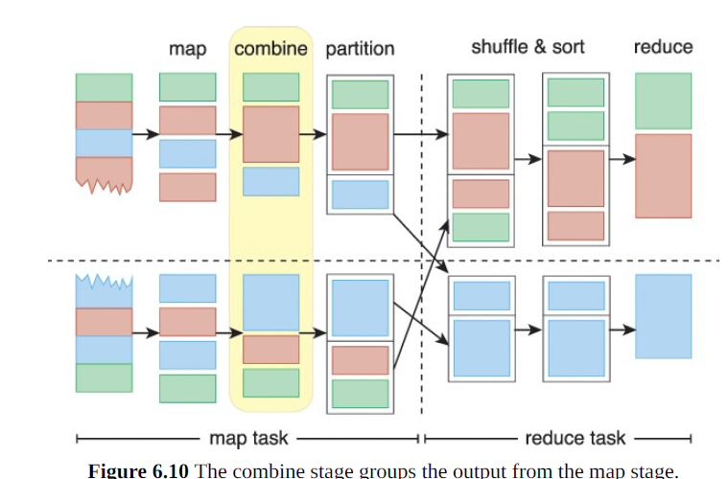
Combine
The combine phase takes a series of K-V pairs, and bundles them up into a batch to be worked on somewhere
This is a preparation stage to get the data to the reducer, or bundle up the data so the reducer can work on several K-V pairs easily
Technically the combine() is usually considered part of reduce, but the distinction isn’t really important
(At this stage the ‘reducer’ has no specific function)

Slide 36
Partition
Combine bundles together data to be reduced
Partition breaks up the combined data so it can be sent to different reducers (maybe the same algorithm of reducers, but just on different clusters)
It’s important to ensure fair and, where applicable, random allocation of data to each reducer
Fair is a tricky concept, you need the correct result but you don’t want to shove all of your data onto a single node in a cluster either.

Slide 37
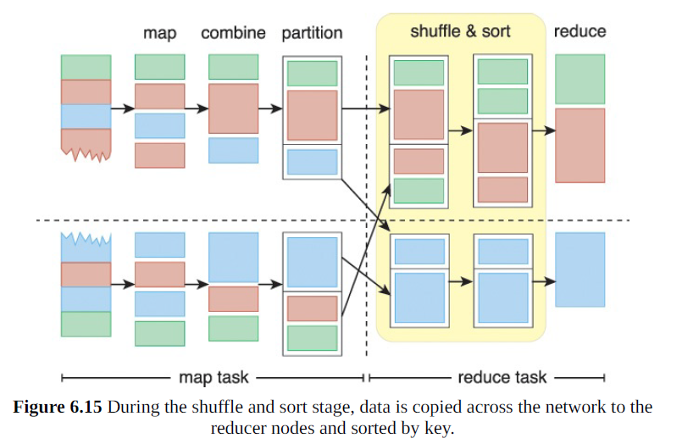
Shuffle and (or) Sort

Slide 38
Shuffle and Sort
the MapReduce engine automatically groups and sorts the key-value pairs according to the keys so that the output contains a sorted list of all input keys and their values with the same keys appearing together.
The way in which keys are grouped and sorted can be customized.
(Depending on your data, sorting by key may or may not screw up your results, remember what I said about things like student numbers? Your student number is your primary key in the database… but it also means something).

Slide 39
Reduce
This is done with a reducer function (user defined)
This function in some way processes each key value pair, or each set of key value pairs to produce a result
The result could be null, or it could be another key value pair, or something else

Slide 40
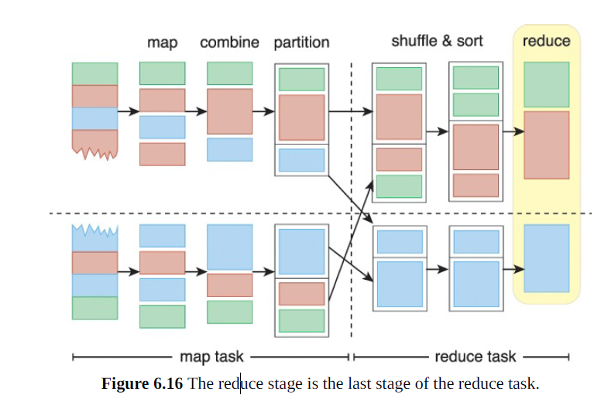
Reduce

Slide 41
Example for Explanation
The input (sales.txt) is divided into two splits.
Two map tasks running on two different nodes, Node A and Node B, extract product and quantity from the respective split’s records in parallel. The output from each map function is a key-value pair where product is the key while quantity is the value.
The combiner then performs local summation of product quantities.
As there is only one reduce task, no partitioning is performed.
The output from the two map tasks is then copied to a third node, Node C, that runs the shuffle stage as part of the reduce task.
The sort stage then groups all quantities of the same product together as a list.
Like the combiner, the reduce function then sums up the quantities of each unique product in order to create the output.

Slide 42
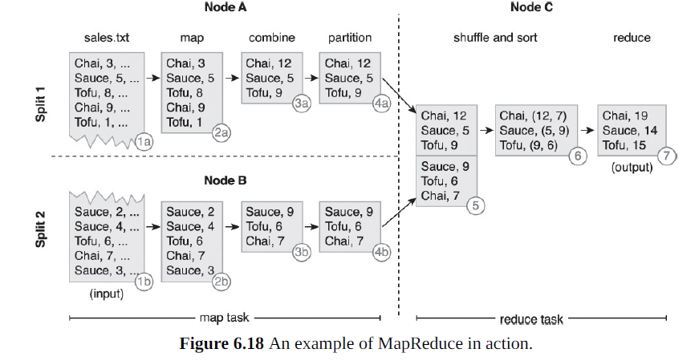

Slide 43
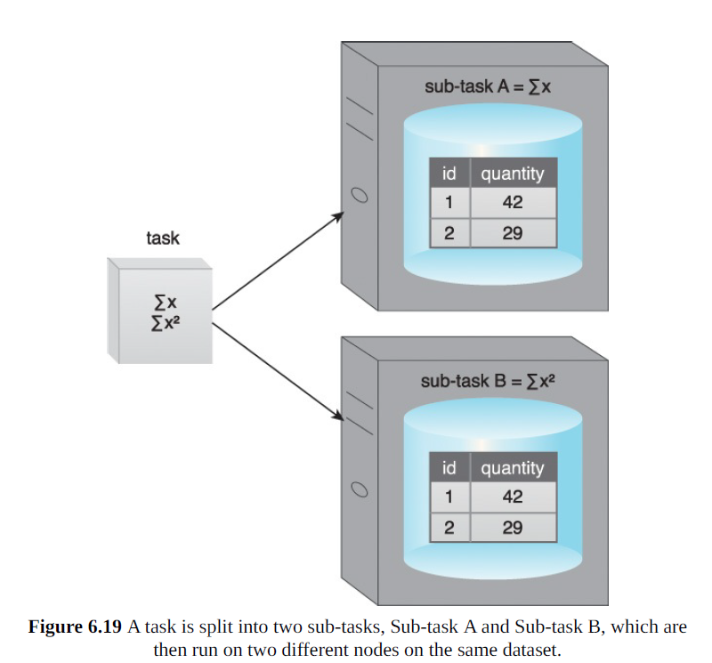
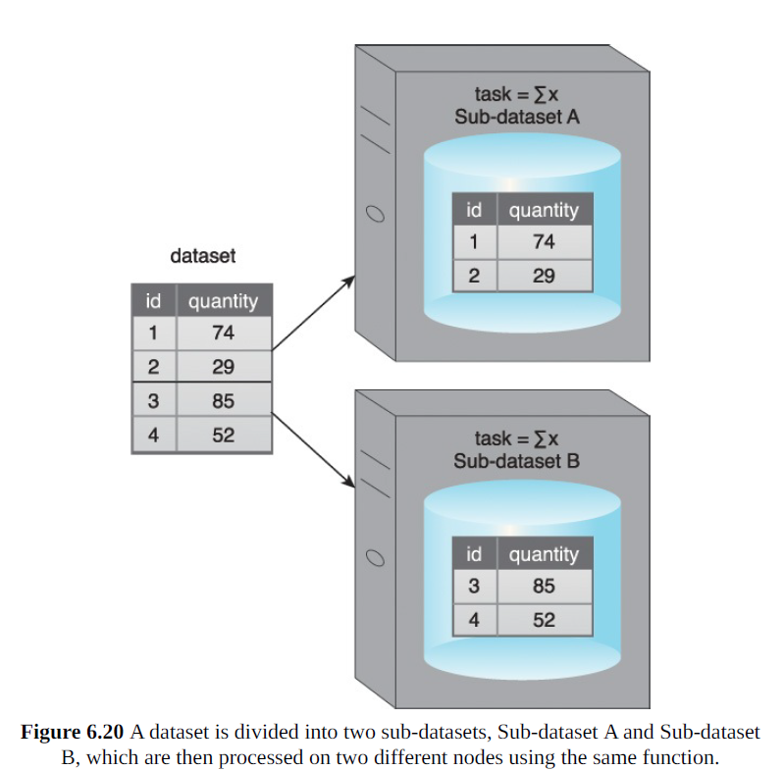
Data VS Task Parallelism

Slide 44
Computer Scientists complaining
MapReduce is a hot new buzzword
But it’s not really a huge departure from past understandings of parallelism, really, it’s not a departure at all.
There are some existing database optimisations which the MapReduce framework doesn’t actually take advantage of (acceleration structures basically)
Granted, it’s conceptually simple so … moving on.

Slide 45
MapReduce Key considerations
Use of relatively simplistic algorithmic logic, such that the required result can be obtained by applying the same logic to different portions of a dataset in parallel and then aggregating the results in some manner.
Availability of the dataset in a distributed manner partitioned across a cluster so that multiple map functions can process different subsets of a dataset in parallel.
Understanding of the data structure within the dataset so that a meaningful data unit (a single record) can be chosen.

Slide 46
MapReduce Key considerations
Dividing algorithmic logic into map and reduce functions so that the logic in the map function is not dependent on the complete dataset, since only data within a single split is available.
Emitting the correct key from the map function along with all the required data as value because the reduce function’s logic can only process those values that were emitted as part of the key-value pairs from the map function.
Emitting the correct key from the reduce function along with the required data as value because the output from each reduce function becomes the final output of the MapReduce algorithm.

Slide 47
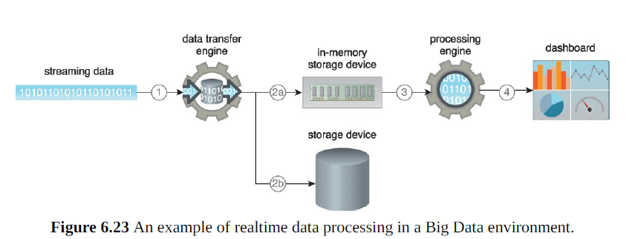
Real Time MapReduce
MapReduce has a real time mode
It’s not necessarily milliseconds or nanoseconds, but it’s still ‘seconds or minutes’ not ‘hours or days’ of delay between input and processing

Slide 48
Weaknesses of Mapreduce/Hadoop
Not great at real time processing (usually on the order of minutes)
Not suited to filter and join operations, need to be re-written
Uses a key-value system in mapper and reducer code
Only works well where the data is, moving data on the network can cripple a network, (particularly when you need iterative ops)
Really bad at working with iterative algorithms (e.g. kmeans clustering)
Doesn’t work well with graphs (Apache Giraph is for that)

Slide 49
Spark
Real time
Processing on a network
Graphs
Iterative execution

Slide 50
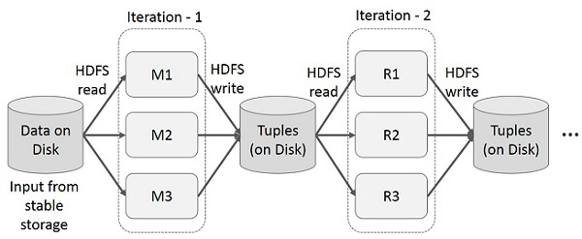
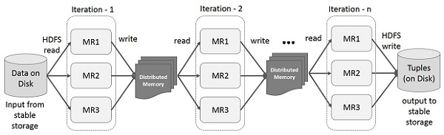
Hadoop vs Spark
Old and Slow
New Hotness
Notes:
https://bigdatapath.wordpress.com/apache-spark-rdd/

Slide 51
Distributed Memory
Really this is all just underlying technical details
Rather than writing to a disk which needs to be read in again, spark writes to RAM (distributed ram across the cluster, but still RAM).
It’s shared memory – so you have to be careful because there’s less shared memory than hard disk, but it’s faster, a LOT faster
(As of ~2019, DDR4 RAM has bandwidth of about 200Gb/s, NVMe SSDs about 25Gb/s, GPU’s are a bit different type of memory but on the order of 5000 Gb/s)
Notes:
Not those figures are bits not bytes

Slide 52

Apache Spark
Tool for speeding up clusters, most notably, clusters running Hadoop
Spark supports: Map and Reduce, SQL style operations, streaming data, Machine learning, and Graph algorithms. (graphs as in graph theory, not plots)

Slide 53
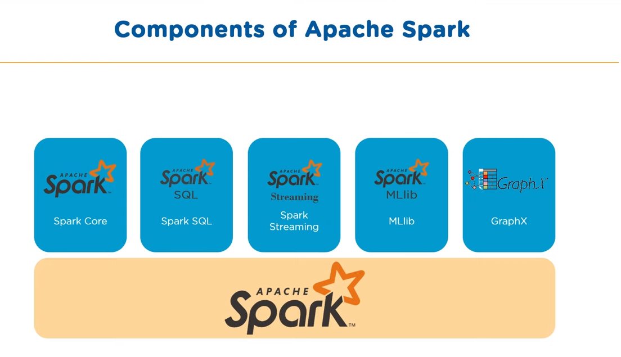
Notes:
https://www.youtube.com/watch?v=znBa13Earms

Slide 54
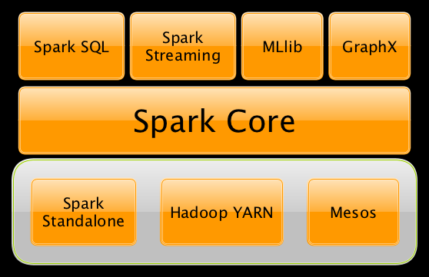
Spark Platform
Notes:
https://jaceklaskowski.gitbooks.io/mastering-apache-spark/spark-overview.html

Slide 55
Spark Components
Spark core – input, output, scheduling
RDD-s these are the core (reduce, join, filter, map), in process
Started with Python, Java, Scala
Secondly, there’s Spark SQL (Schema RDD) – semi and structured data. ODBC/JDBC (open database connector, java dbc), supports SQL

Slide 56
Three more Spark components
Spark streaming Built on spark core for getting data, performing RDD transformations, and scheduling
MLLib, we won’t talk much about it today, but it’s a library, for machine learning.
GraphX – Distributed processing framework for managing graph data structures

Slide 57
Spark DataFrame
In spark you have a dataframe… which is basically just a relational table like in SQL
You run queries etc. on your dataframes
You can connect Spark to an SQL database (usually to read in the database into a dataframe)
You manage your dataframe as a Dataset (which is really a subset of data)

Slide 58
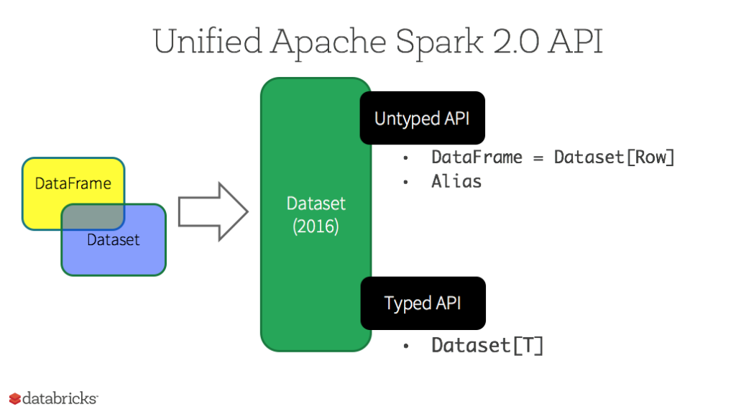
Spark
Spark is built around Resilient Distributed Datasets (RDD)
RDD is the collection of objects you partition up on the cluster
(In spark version > 2.0 you get at this through the Dataset API)
Some technobabble: Datasets are strongly-typed, immutable, and they are automatically serialised (though I am not all that confident in them being automatically serialised well)
Dataframes are untyped, and are a dataset of Row

Slide 59
Dataset Operations
Transformations – map, filter, select, aggregate
Actions – count, show, write to file

Slide 60
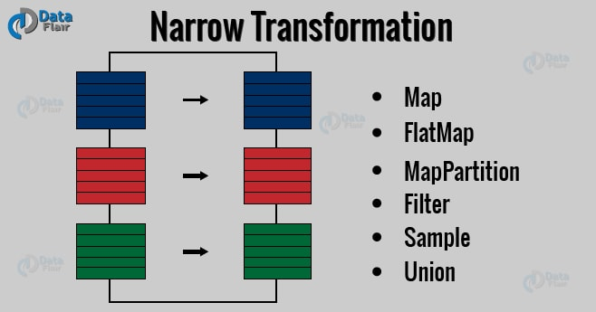
RDD Transformations - Narrow
Narrow Transforms all elements required are in a single parent RDD
(map and filter)

Slide 61
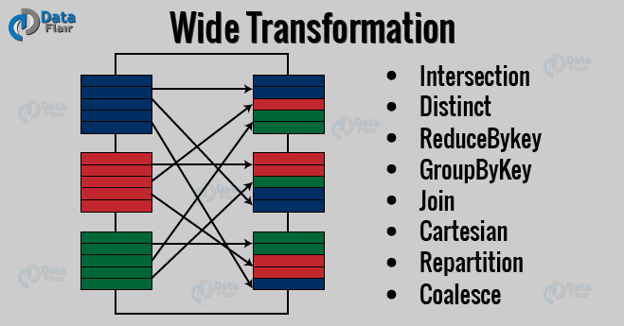
RDD Transformations - Wide
In a wide transformation your data can be in many RDDs which are not resident together

Slide 62
Dataset types
Spark datasets are basically strongly typed Java virtual machine objects
Datasets can be from files, tables, external databases, other datasets
Note that R and Python behave slightly differently than Java and Scala because R and Python are weakly typed languages, so you can just do things like row.columnName and expect it to work… which it will as long as columnName exists, and if it doesn’t your program crashes.

Slide 63
DataFrame - > Dataset
Imagine we have the following DataFrame
To make that a Dataset we need to filter out the null value
+----+-------+
| age| name|
+----+-------+
|null|Michael|
| 30| Andy|
| 19| Justin|
+----+-------+
val pplFiltered = people.filter("age is not null")
+------+---+
| name|age|
+------+---+
| Andy| 30|
|Justin| 19|
+------+---+

Slide 64
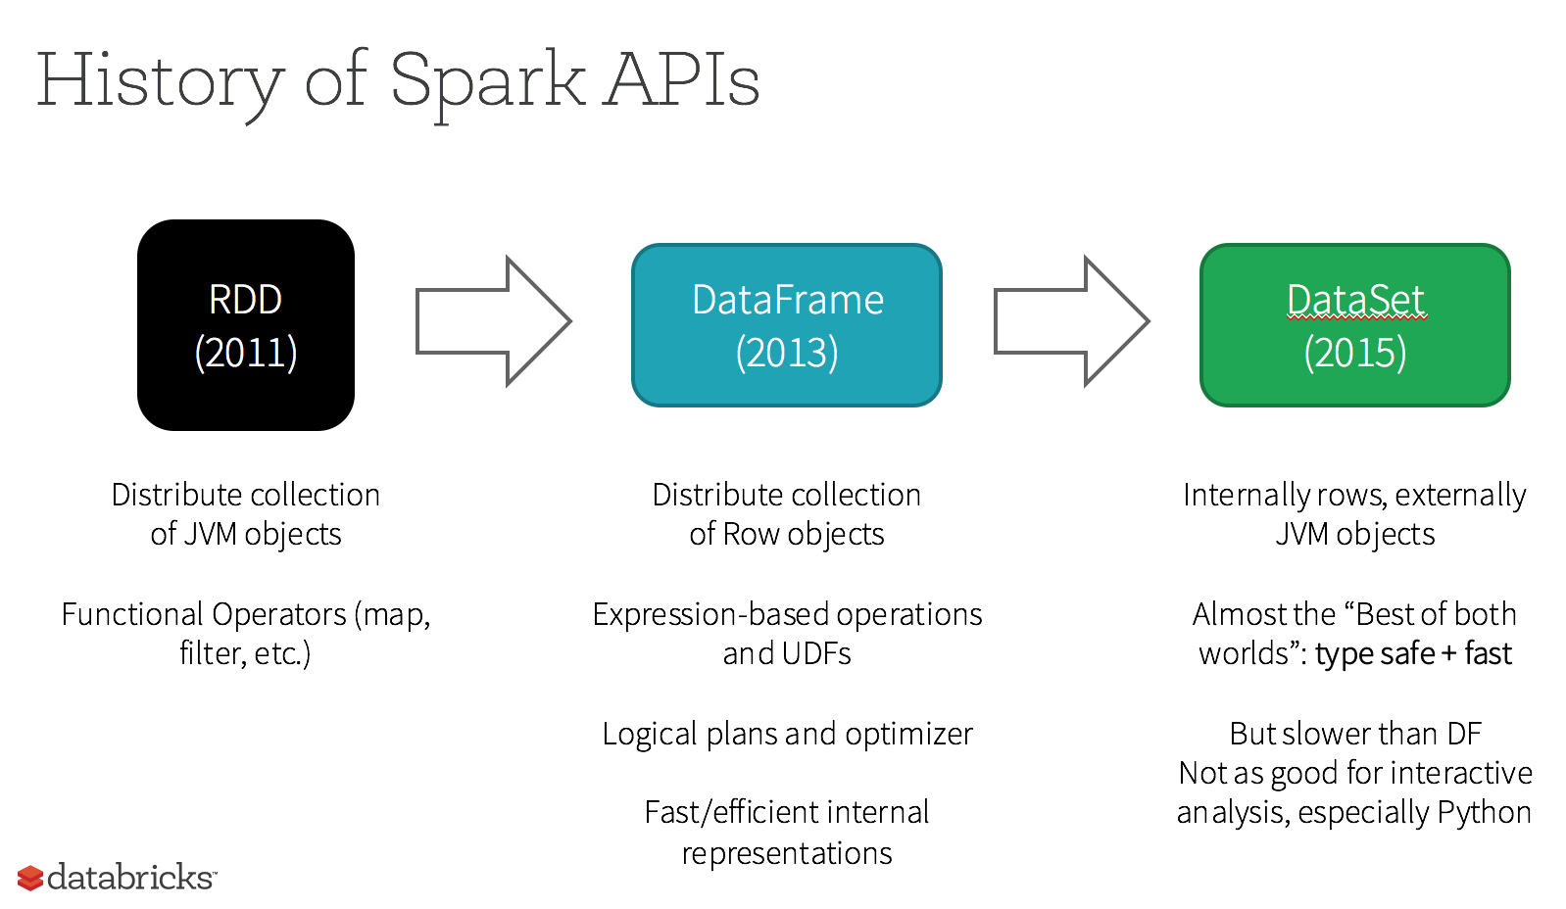

Slide 65
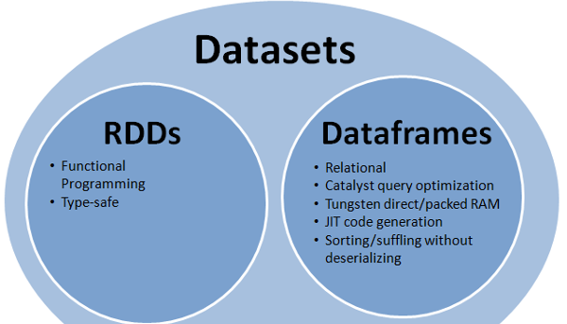

Slide 66
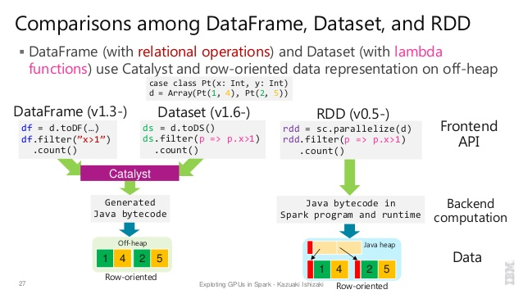
RDD, DataFrame,
Notes:
https://stackoverflow.com/questions/31508083/difference-between-dataframe-dataset-and-rdd-in-spark

Slide 67
Spark Runs on Hadoop
Spark actually runs on a bunch of Hadoop platform stuff
I won’t bore you with details (there’s a bunch of file system and resource management stuff that goes with Hadoop that Spark runs on top of)

Slide 68

FLINK
Flink is a purely a stream processing framework
There are two kinds of streams – bounded and unbounded

Slide 69
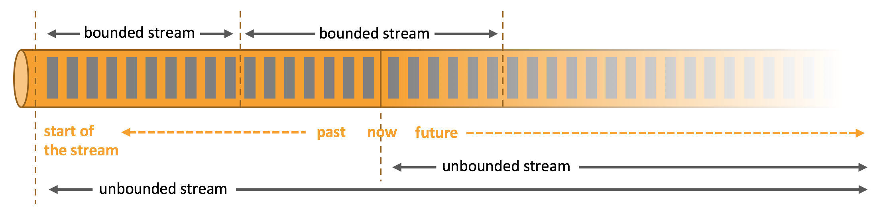
Flink - DataStreams
Unbounded streams have a start point, but have no definite end. They are continuously processed. Unbounded streams usually either require or force data to be inputted in some order to ensure logical consistency (e.g. data must be entered in the order it is generated)
Bounded Streams have a clear start and end. Bounded streams sort their own data with a mini batch

Slide 70
Use cases
Event driven
Data Analytics
Data pipeline

Slide 71
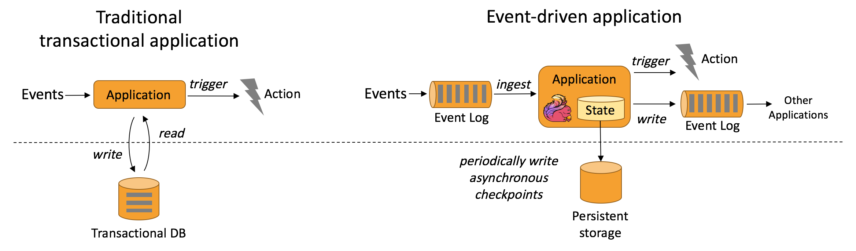
Flink – Event Driven Applications
On an event the (stateful) system responds with a computation, state change or external action

Slide 72
Flink Event Driven Applications
This is similar to classic applications which read data to and from a transactional database
In Flink EDAs – data and computation are co local, where fault-tolerance happens from periodic checkpoint writes
This means local data access (in RAM), updates can be asynchronous
Flink guarantees exactly once consistency (data for computation only exists once, logically if not physically),

Slide 73
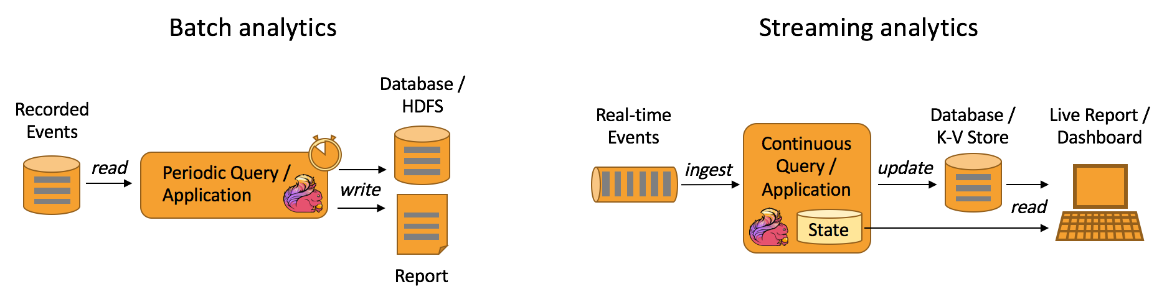
Flink - Analytics
Queries, or applications on bounded data sets or recording events.
When data is added a query needs to be re-run (that is the nature of analytics)

Slide 74
Flink Analytics
Flink Analytics can be performed real time
Results are committed asynchronously to a transactional database
Allows for continuously updated dashboards or reporting

Slide 75
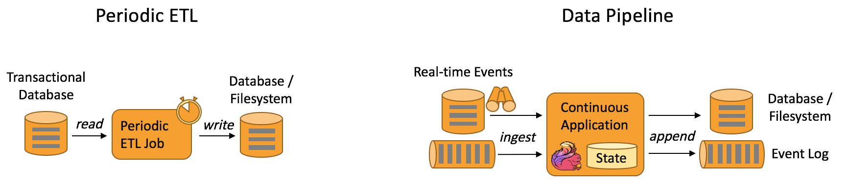
Flink – Data Pipeline
Extract, Transform and Load to convert or move data between nodes
E.g. periodically copy data between databases (backup, to analytics etc.)
Data pipelines are like ETL

Slide 76
Flink – Data Transformations
Flink works on collections of data and has built in methods for
Filter
Map
Join
Group
Aggregate

Slide 77
Flink DataSets and DataStreams
DataSets are for bounded problems
DataStreams are for unbounded ones
These are similar to but not java collections, you can’t get at the elements inside them, and once created you cannot add or remove elements

Slide 78
Flink Program
Flink programs look like regular programs that transform collections of data. Each program consists of the same basic parts:
Obtain an execution environment,
Load/create the initial data,
Specify transformations on this data,
Specify where to put the results of your computations,
Trigger the program execution

Slide 79
https://data-artisans.com/blog/flink-sql-powerful-querying-of-data-streams
https://data-flair.training/blogs/hadoop-vs-spark-vs-flink/

Slide 80
Deploying Spark/Flink/Hadoop
You can install all of these tools on linux natively, it’s a thing, it works.
But you can also containerize them

Slide 81
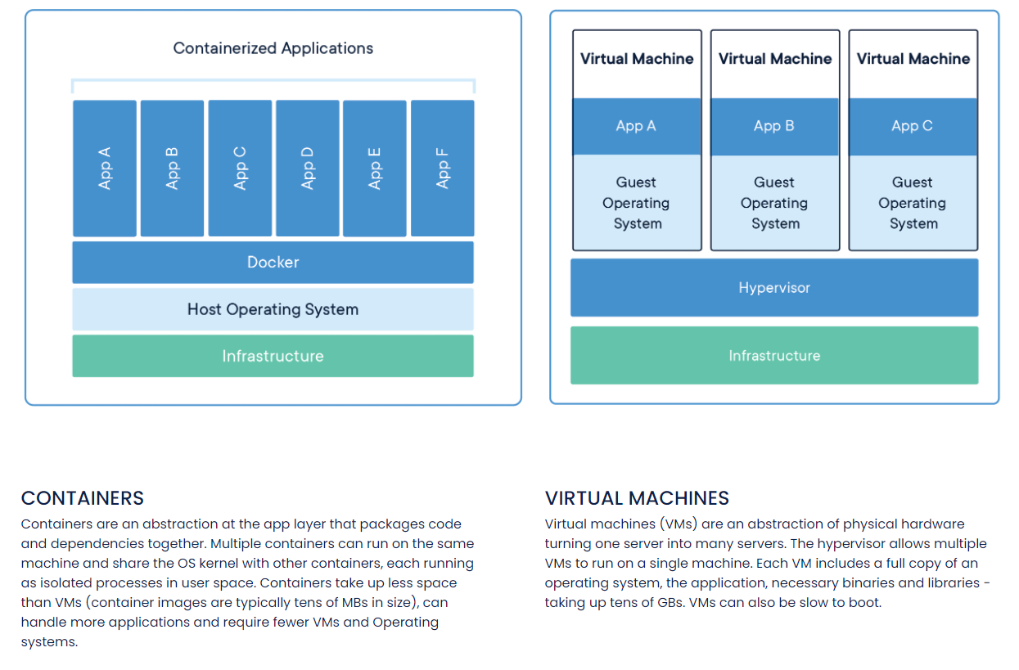
Containers (Note: Both VMs and Containers are useful and sometimes used together)
Notes:
https://www.docker.com/resources/what-container

Slide 82
Running One of the Big Data Tools
So you’d run one of the Big data applications (Spark/Hadoop etc) inside a container
Many containers? Wrangle with Kubernetes

Slide 83
Docker in HPC: No
Docker is designed around all of the data (and containers) being visible and controllable by all users all the time, and control of a container essentially gives you admin rights on the running machine
This makes sense for that sort of workload
But for HPC (where you isolate data and control between users) there’s singularity. Singularity is compatible with Docker containers.
The idea is to orchestrate resources, schedule, and handle higher performance applications. Docker works well when you have many microservices, Singularity is for many numerical heavy macro services

Slide 84
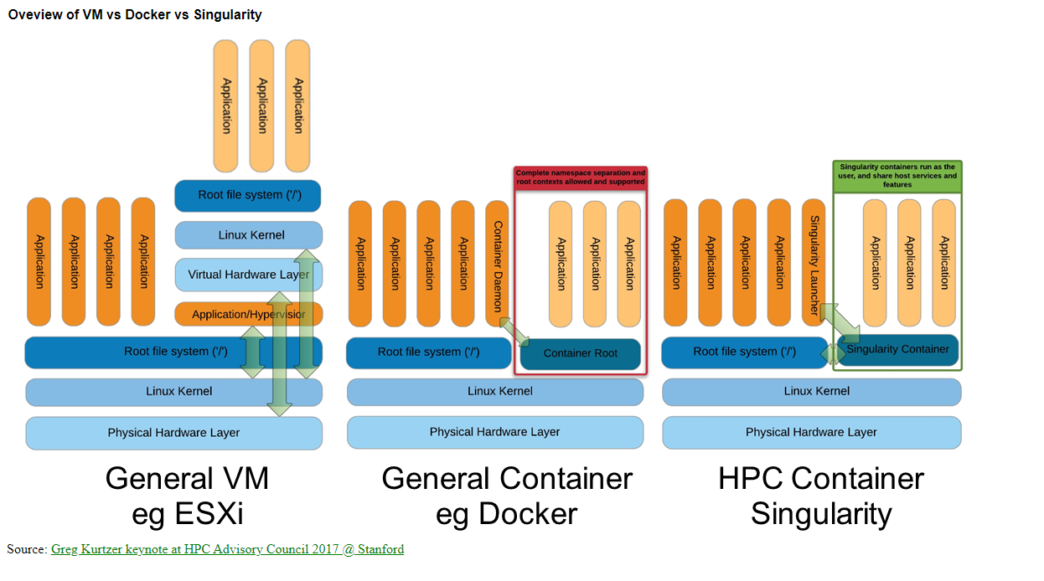
Notes:
https://tin6150.github.io/psg/blogger_container_hpc.html

